Slide 1


MEDIA CAMPAIGN DATA VALIDATION & ANALYSIS
By: Jerome Gameli Kofi Davor

Slide 2
INTRODUCTION
This data validation meeting for a media campaign aims to review and validate the data collected during the media campaign from 2015 to 2019, as well as verify its accuracy and reliability. By conducting this validation process, we will gain valuable insights into the performance and effectiveness of the campaign for the stated period, enabling us to make informed decisions and optimize future media campaign strategies.

Slide 3
OBJECTIVE
To Validate the accuracy and reliability of data collected
Provide comprehensive weekly time-series analysis on data collection on media campaign from 2015 to 2019.
Identify key trends and insights, and make data driven recommendations to optimize future campaigns.
Evaluate the effectiveness and performance of the media campaign based on Key Performance Indicator metrics for the stated period:
Cost
Impressions
Channels

Slide 4
DATA SOURCE
Raw data of client’s media campaign was collected and submitted for the purposes of data validation & analysis.
The data contained information on:
Date of campaign
Campaign
Cost
Campaign impressions
Campaign Channel
Brand Type: Brand / Generic
Campaign Type: Prospecting / Remarketing
In total the raw data had 75,841 rows and 7 columns of data.

Slide 5
DATA VALIDATION PROCESS
Data Merging Process
Data for the validation process were stored in two excel sheets.
Raw data – Contained information on campaign date, campaign names, cost and impressions.
Campaign lookup – Contained information on campaign names, channel, brand type and campaign type.
Both tables were merged using the campaign column which is found in both tables.
Each campaign information in the raw data sheet was matched to its respective channel, brand type and campaign type from the campaign lookup sheet.
The information from both were merged into a new data sheet.

Slide 6
DATA VALIDATION PROCESS
Data Cleaning & Transformation
Removed the dates attached to 22 campaign names in the campaign coulmn.
Removed 778 Facebook and Instagram related posts in the campaign column.
Removed all data related to Facebook page likes.
Removed all data related Facebook post engagement likes.
Replaced all spaces in campaign names with underscores, colons with pipe symbol, and removed square brackets and parenthesis.
Corrected spelling in campaign names to ensure uniformity.
Extracted the week, month and year information from the date column and stored each in separate columns.
Removed all campaign information that had both cost and impressions recorded as 0.
Rounded up all decimal point impression values to the nearest whole number.

Slide 7
DATA ANALYSIS & KEY FINDINGS

Slide 8
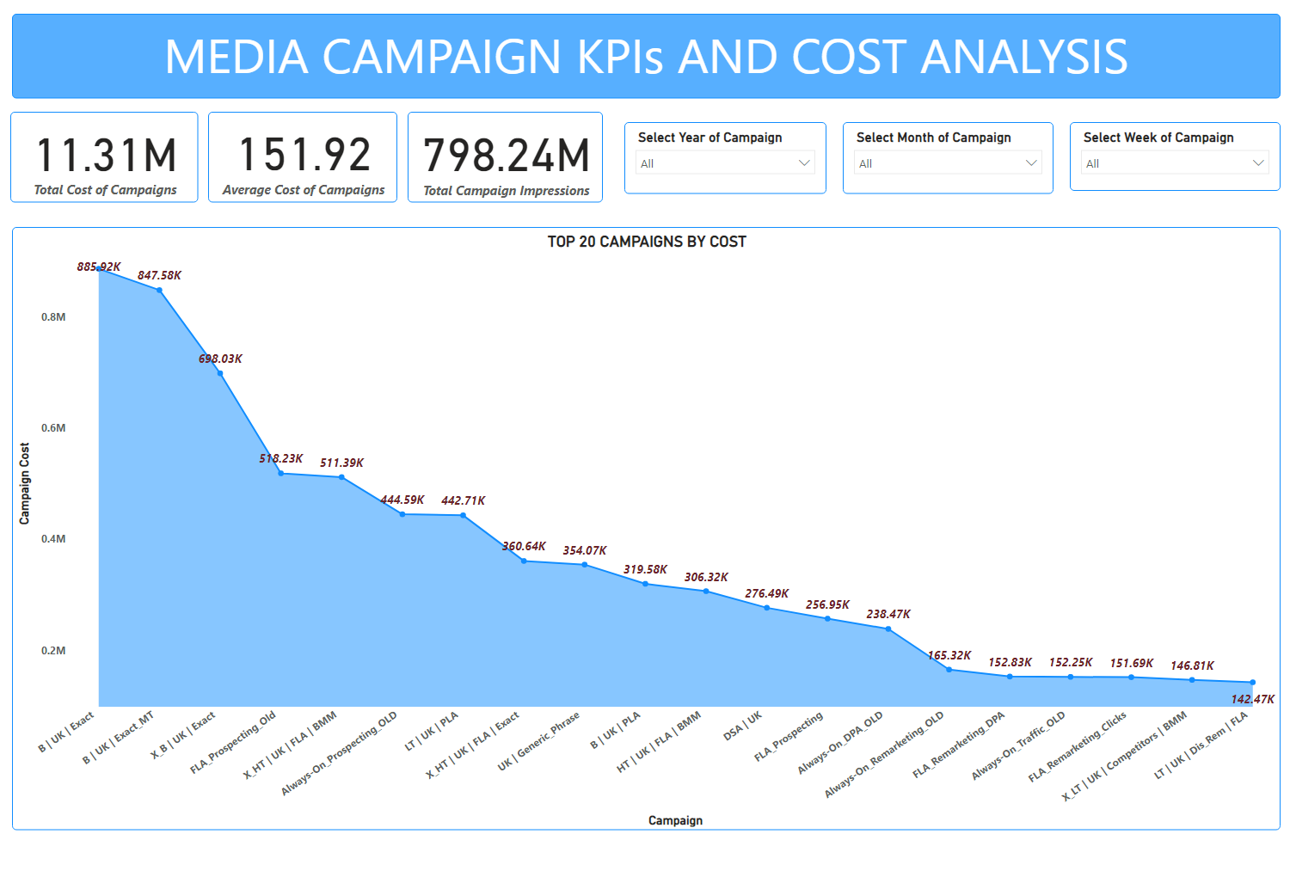

Slide 9
Total cost of all media campaigns from 2015 to 2019 stood at approximately 11,310,000.00 (11.31 million).
The average cost of all media campaigns stood at approximately 151,910.00 (151.91 thousand).
Total impressions for all media campaigns for the given period was approximately 798,240,000 (798.24 million).
For the top 20 media campaigns from 2015 to 2019;
The campaign ‘B |U K | Exact’ had the highest cost with a total of 885,917.00.
The campaign ‘LT | UK | Dis_Rem | FLA’ had the lowest cost among the top 20 campaigns for the stated period with a total of 142,474.87.

Slide 10
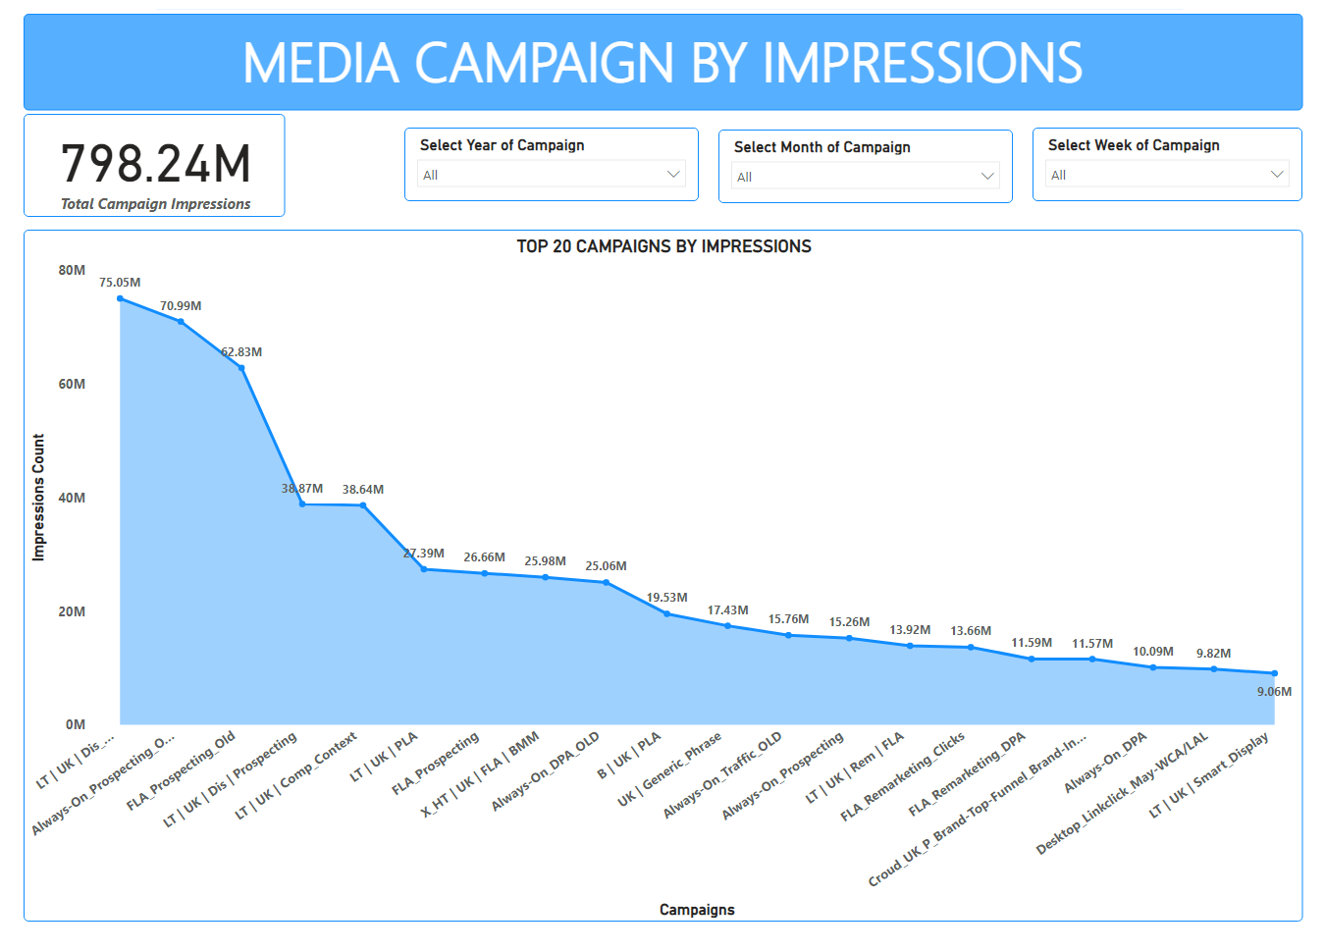

Slide 11
For the top 20 campaigns with respect to impressions for all media campaigns from 2015 to 2019;
The campaign ‘LT | UK | Dis_Rem | FLA’ had the highest number of impressions with a total count of 75,054,454 (~75 million).
The campaign ‘LT | UK | Smart_Display’ had the lowest number of impressions among the top 20 campaigns with a total count of 9,060,098 (~9 million).

Slide 12
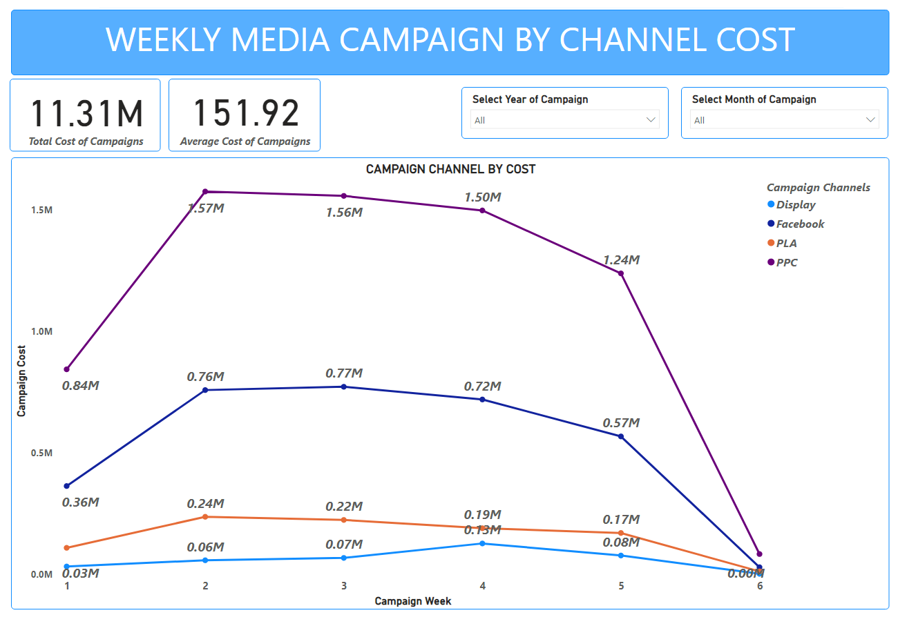

Slide 13
A total of four campaign channels were utilized within the stated period (2015 - 2019):
Facebook
Display
PLA – Product Listing Ad
PPC – Pay-Per-Click
This analysis was done with respect to weekly trends of the cost and impressions of these campaign channels for the stated period.
Campaigns with respect to channel costs in the order of highest to lowest were;
PPC > Facebook > PLA > Display
PPC had the highest cost followed by Facebook then PLA, with Display having the least cost.
Campaigns with respect to channel impressions in the order of highest to lowest were;
Facebook > PPC > Display > PLA
It is only in week 4 that Display channel had a higher impressions count than PPC.

Slide 14
The table below details the total cost of all media campaigns with respect to all utilized campaign channels for the stated period (2015 to 2019).
For all the weeks recorded, PPC (Pay-Per-Click) channel recorded the highest cost with Display channel recording the lowest.
WEEK | CAMPAIGN BY CHANNEL COST
 | PPC | Facebook | PLA | Display
1 | 843,382.34 | 363,410.50 | 109,302.48 | 32,496.93
2 | 1,574,518.06 | 758,076.73 | 236,921.46 | 58,141.79
3 | 1,556,555.35 | 771,597.35 | 223,932.03 | 67,799.73
4 | 1,496,662.10 | 719,356.41 | 189,822.61 | 127,234.19
5 | 1,237,843.38 | 567,398.56 | 170,380.81 | 77,720.20
6 | 83,724.09 | 29,478.58 | 12,304.85 | 2,473.20

Slide 15
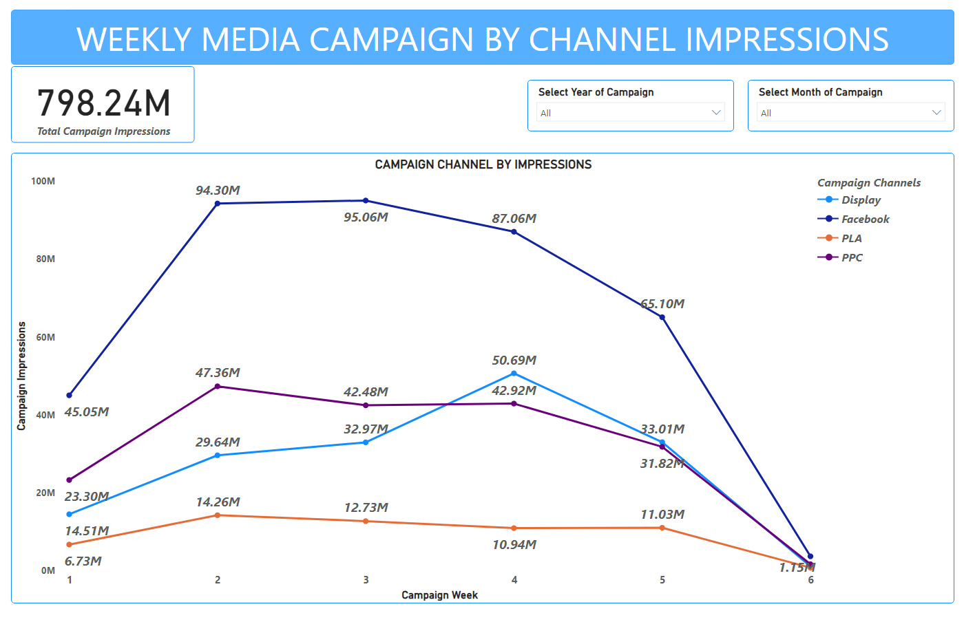

Slide 16
The table below details the total impressions count of all media campaigns with respect to all utilized campaign channels for the stated period (2015 to 2019).
For all the weeks recorded, Facebook channel recorded the highest cost with PLA (Product Listing Ad) channel recording the lowest.
WEEK | CAMPAIGN BY CHANNEL IMPRESSIONS COUNT
 | Facebook | PPC | Display | PLA
1 | 45,045,549 | 23,299,572 | 14,506,139 | 6,725,432
2 | 94,302,459 | 47,358,363 | 29,640,073 | 14,257,351
3 | 95,061,634 | 42,477,746 | 32,967,751 | 12,728,789
4 | 87,055,801 | 42,919,324 | 50,693,118 | 10,942,331
5 | 65,096,738 | 31,818,415 | 33,013,342 | 11,030,674
6 | 3,701,896 | 1,670,873 | 1,146,850 | 780,985

Slide 17
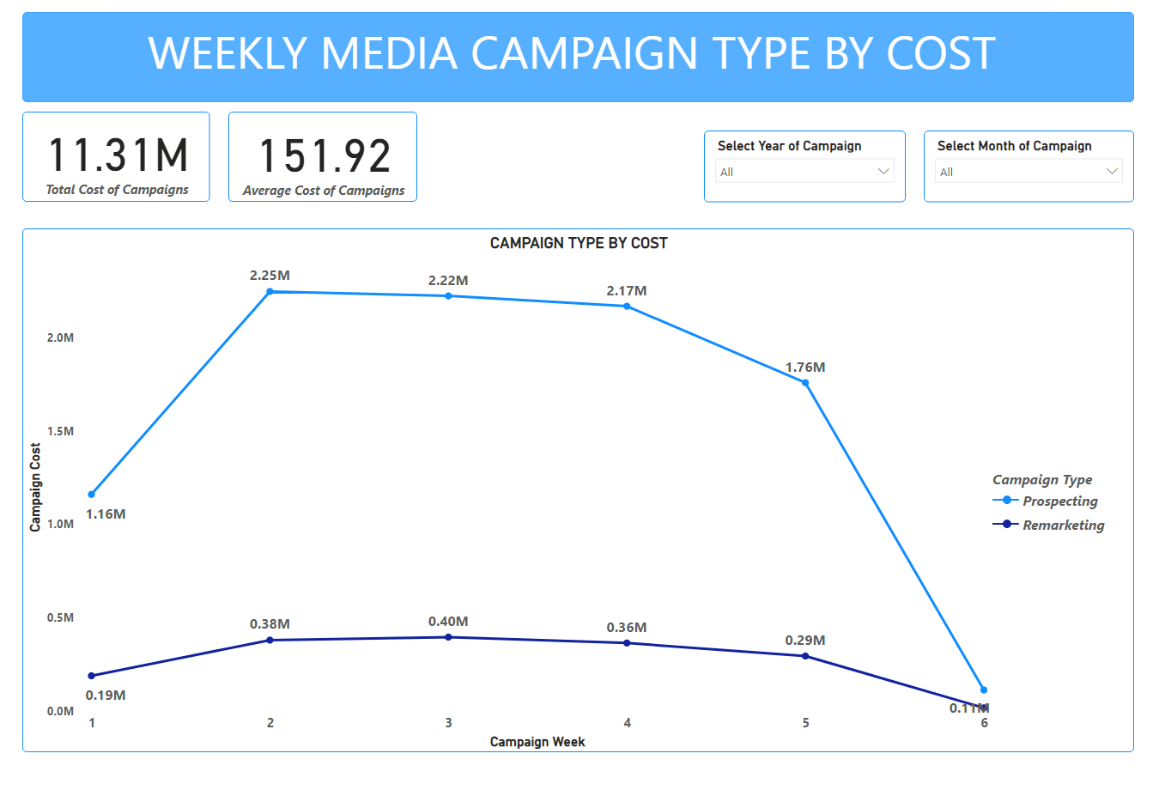

Slide 18
A total of two campaign types were employed within the stated period (2015 - 2019):
Prospecting
Remarketing
The analysis was done with respect to weekly trends of the cost and impressions of these campaign types for the stated period.
Campaign type with respect to costs in the order of highest to lowest were;
Prospecting > Remarketing
Campaign type with respect to impressions in the order of highest to lowest were;
Prospecting > Remarketing
For all the weeks of all media campaign for the stated period, Prospecting recorded both the highest with respect to cost and impressions, with Remarketing recording the lowest among the two with respect to cost and impressions.

Slide 19
The table below details the total cost of all media campaigns with respect to campaign types for the stated period (2015 to 2019).
For all the weeks recorded, Prospecting recorded the highest costs with Remarketing recording the lowest.
WEEK | CAMPAIGN TYPE BY COST
 | Prospecting | Remarketing
1 | 1,160,550.40 | 188,042.11
2 | 2,248,398.67 | 379,259.37
3 | 2,224,537.30 | 395,347.16
4 | 2,169,384.48 | 363,690.83
5 | 1,759,411.40 | 293,931.55
6 | 111,861.52 | 16,119.20

Slide 20
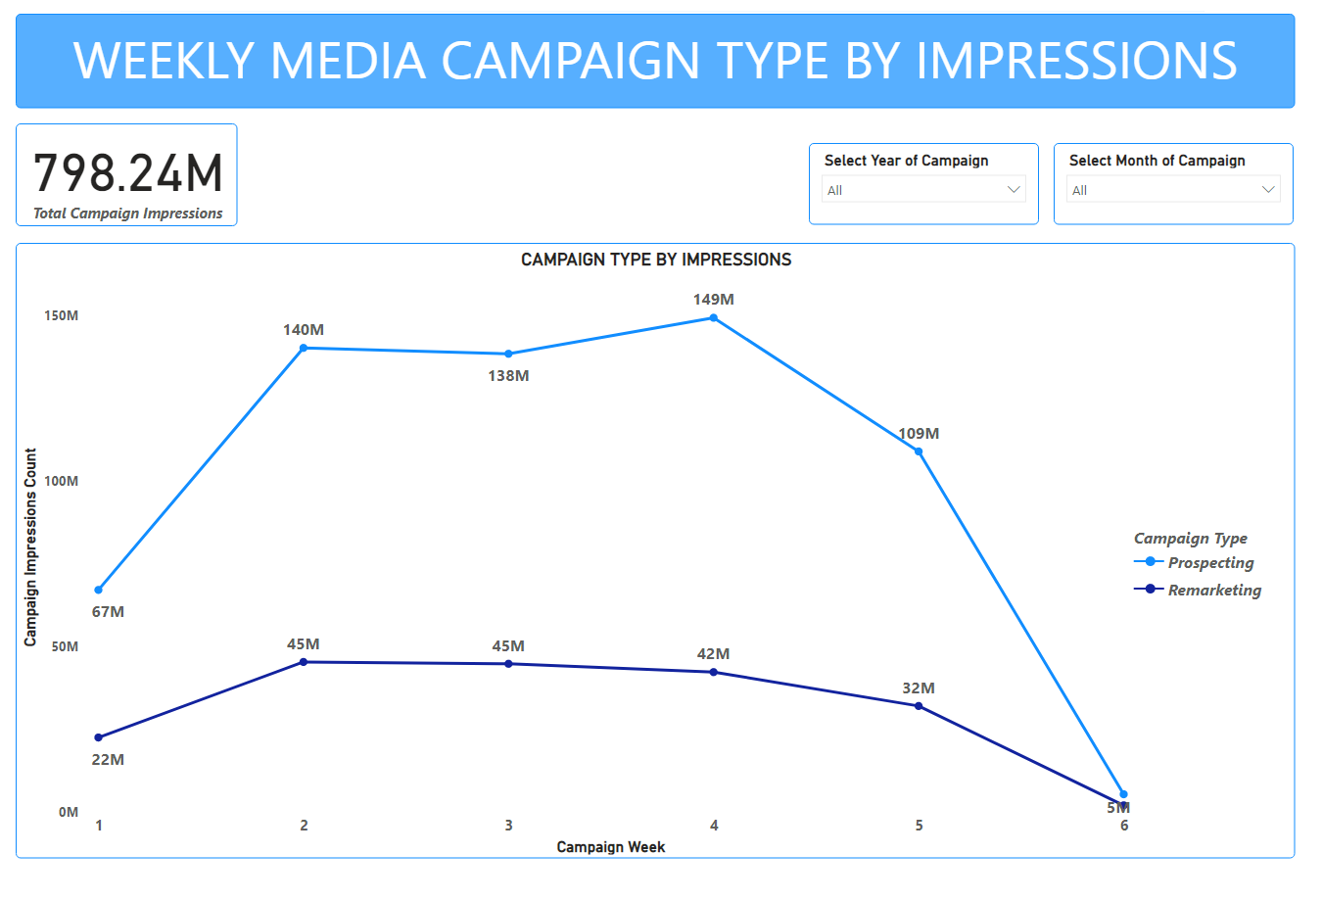

Slide 21
The table below details the total cost of all media campaigns with respect to campaign types for the stated period (2015 to 2019).
For all the weeks recorded, Prospecting recorded the highest costs with Remarketing recording the lowest.
WEEK | CAMPAIGN TYPE BY IMPRESSIONS COUNT
 | Prospecting | Remarketing
1 | 67,091,526 | 22,485,166
2 | 140,245,732 | 45,312,514
3 | 138,469,113 | 44,766,807
4 | 149,359,425 | 42,251,149
5 | 108,949,608 | 32,009,561
6 | 5,320,519 | 1,980,085

Slide 22
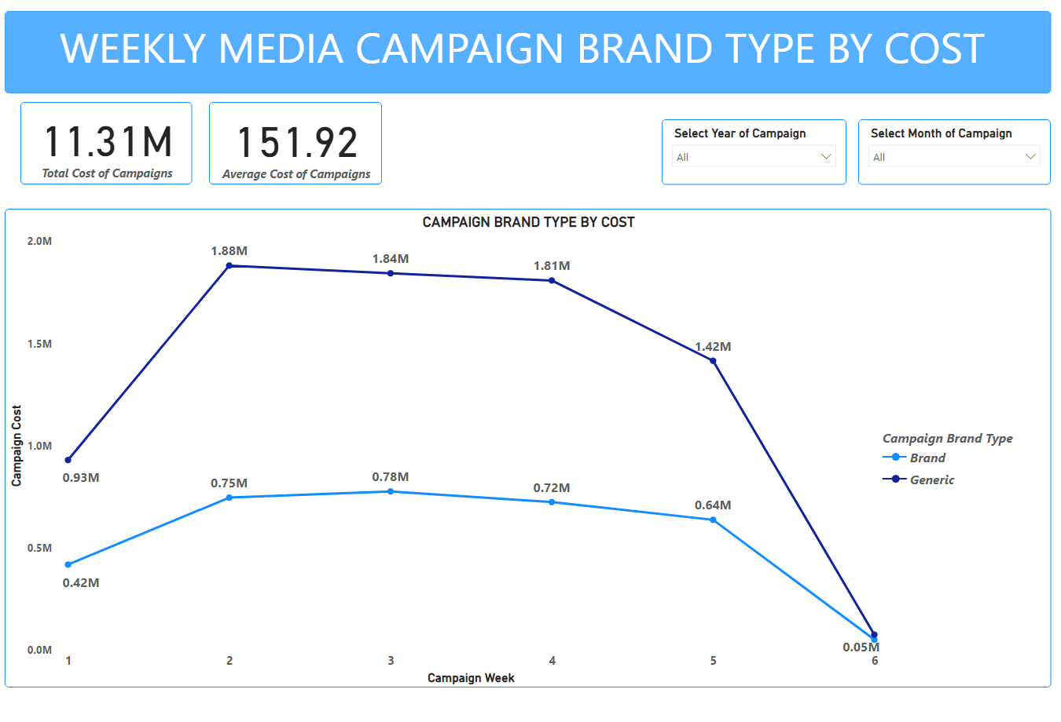

Slide 23
A total of two campaign brand types were employed within the stated period (2015 - 2019):
Brand
Generic
Analysis was done with respect to weekly trends of the cost and impressions of these campaign brand types for the stated period.
Brand type with respect to costs in the order of highest to lowest were;
Generic >Brand
Campaign type with respect to impressions in the order of highest to lowest were;
Generic >Brand
For all the weeks of all media campaign for the stated period, Generic brand types recorded the highest with respect to cost and impressions, with Branded brand types recording the lowest among the two with respect to cost and impressions.

Slide 24
The table below details the total cost of all media campaigns with respect to campaign brand types for the stated period (2015 to 2019).
For all the weeks recorded, Generic brands recorded the highest costs with Branded brands recording the lowest.
WEEK | CAMPAIGN BRAND TYPE BY COST
 | Generic | Brand
1 | 930,039.59 | 418,552.66
2 | 1,881,398.95 | 746,259.09
3 | 1,843,469.28 | 776,415.18
4 | 1,808,504.80 | 724,570.51
5 | 1,415,625.89 | 637,717.06
6 | 76,029.63 | 51,951.09

Slide 25
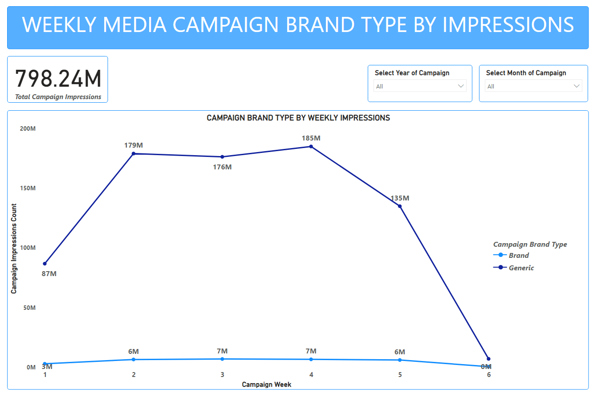

Slide 26
The table below details the impressions count of all media campaigns with respect to campaign brand types for the stated period (2015 to 2019).
For all the weeks recorded, Generic brands recorded the highest impressions with Branded brands recording the lowest.
WEEK | CAMPAIGN BRAND TYPE BY IMPRESSIONS COUNT
 | Generic | Brand
1 | 86,777,973 | 2,798,719
2 | 179,154,200 | 6,404,046
3 | 176,420,465 | 6,815,455
4 | 185,093,146 | 6,517,428
5 | 134,988,833 | 5,970,336
6 | 6,936,224 | 364,380

Slide 27
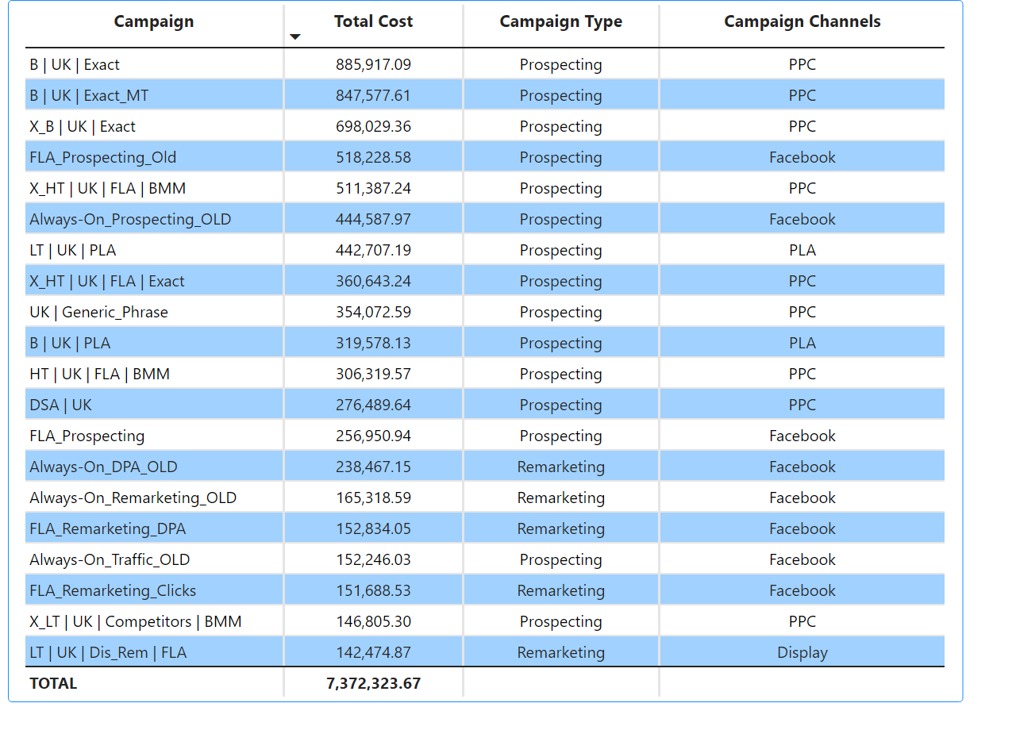

Slide 28
The above slide shows the table of the top 20 media campaigns from 2015 to 2019 based on their total cost.
This is with respect to the type of campaign, whether it was a prospecting or remarketing campaign and the respective campaign channels associated with each campaign.
From the table, Prospecting campaign type had the highest frequency of the top 20 campaigns with a total number of 15.
It also accounted for all the highest costs for the top 20 campaigns.
Remarketing campaign type had the least frequency of the top 20 campaigns with a total number of 5.

Slide 29
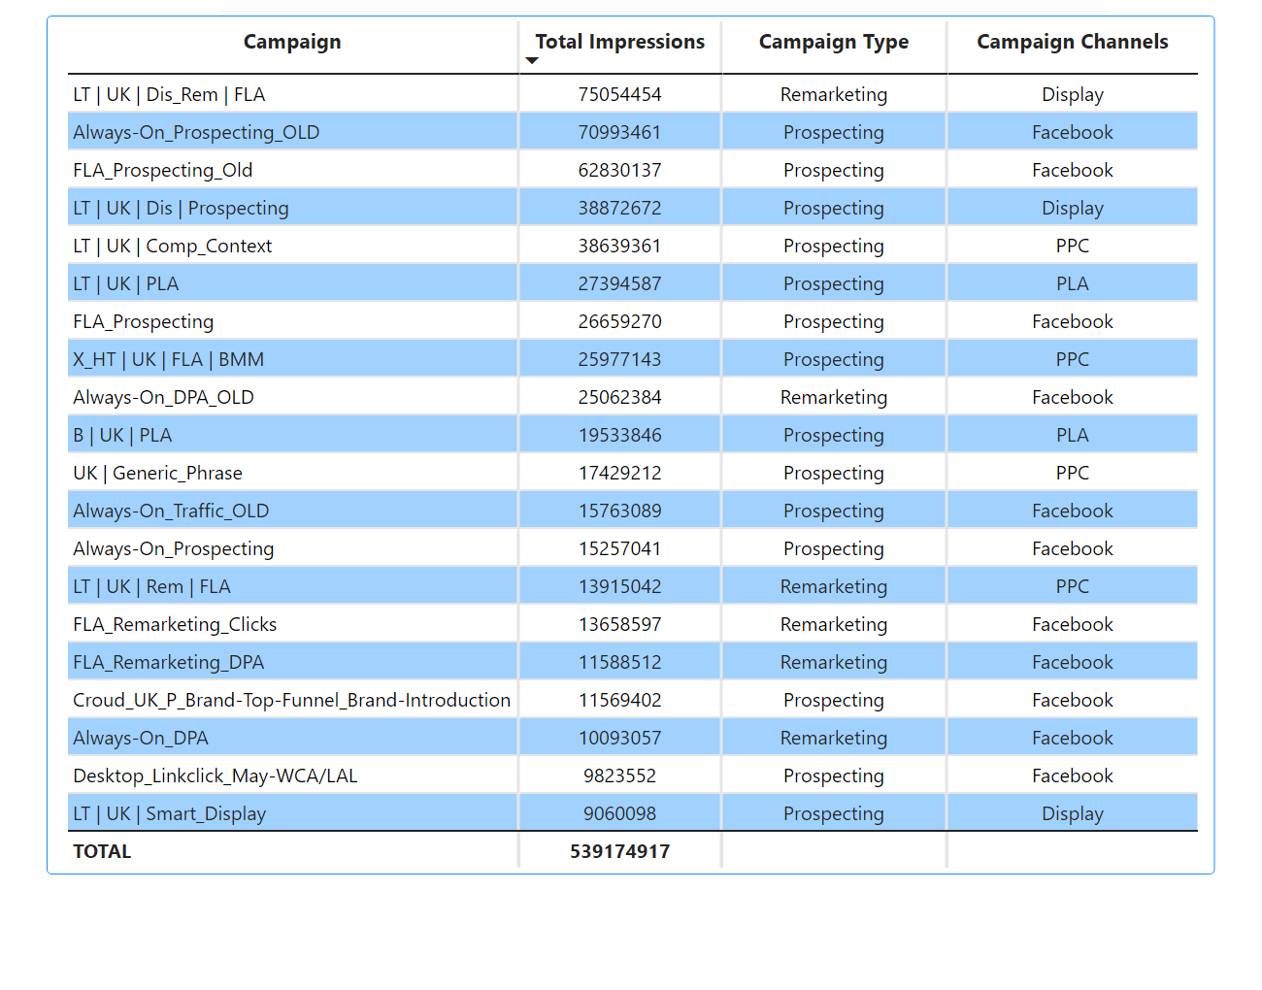

Slide 30
The above slide shows the table of the top 20 media campaigns from 2015 to 2019 based on their total impressions count.
This is with respect to the type of campaign, whether it was a prospecting or remarketing campaign and the respective campaign channels associated with each campaign.
From the table, Prospecting campaign type had the highest frequency of the top 20 campaigns with a total number of 14.
Prospecting also accounted for most of the campaign costs for the top 20 campaigns.
Remarketing campaign type had the least frequency of the top 20 campaigns with a total number of 6.
Remarketing campaign type with the campaign name ‘LT | UK | Dis_Rem | FLA’ recorded the highest number of impressions, utilizing the Display campaign channel.

Slide 31
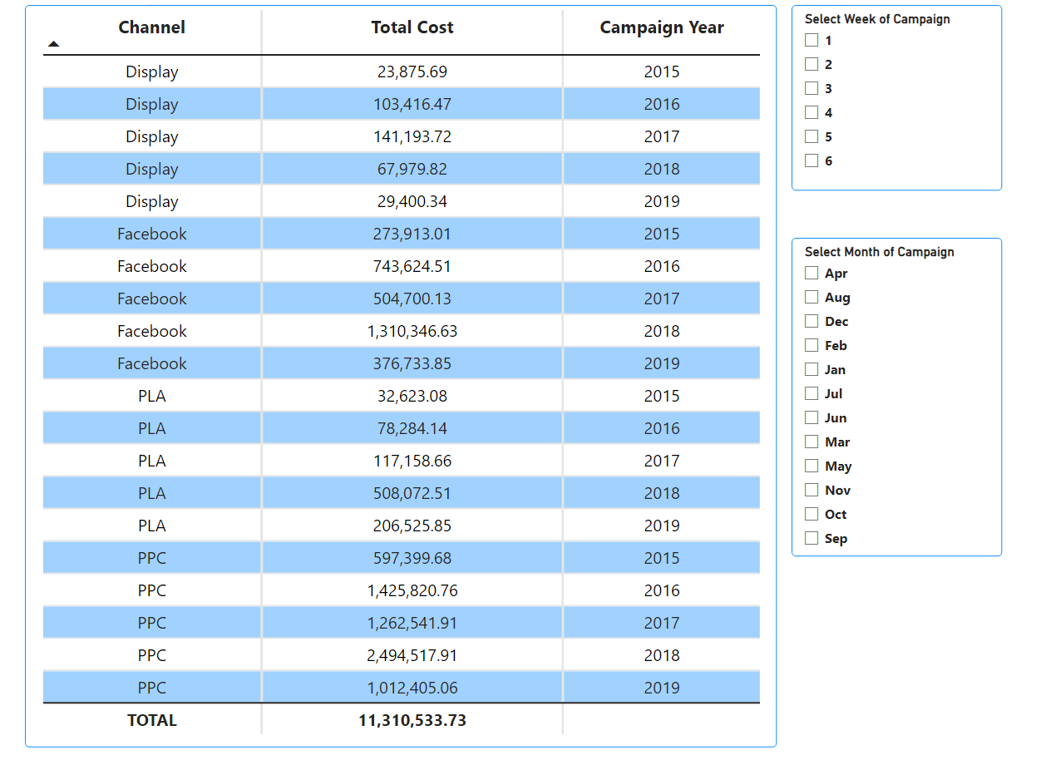

Slide 32
The above slide shows a table of all media campaign channels.
These channels have been aggregated into the various years the campaigns was undertaken and the cost for each campaign channel with respect to each year (2015 to 2019).
Slicers for the table is used to further aggregate the table by
Week of campaign
Month of the campaign

Slide 33
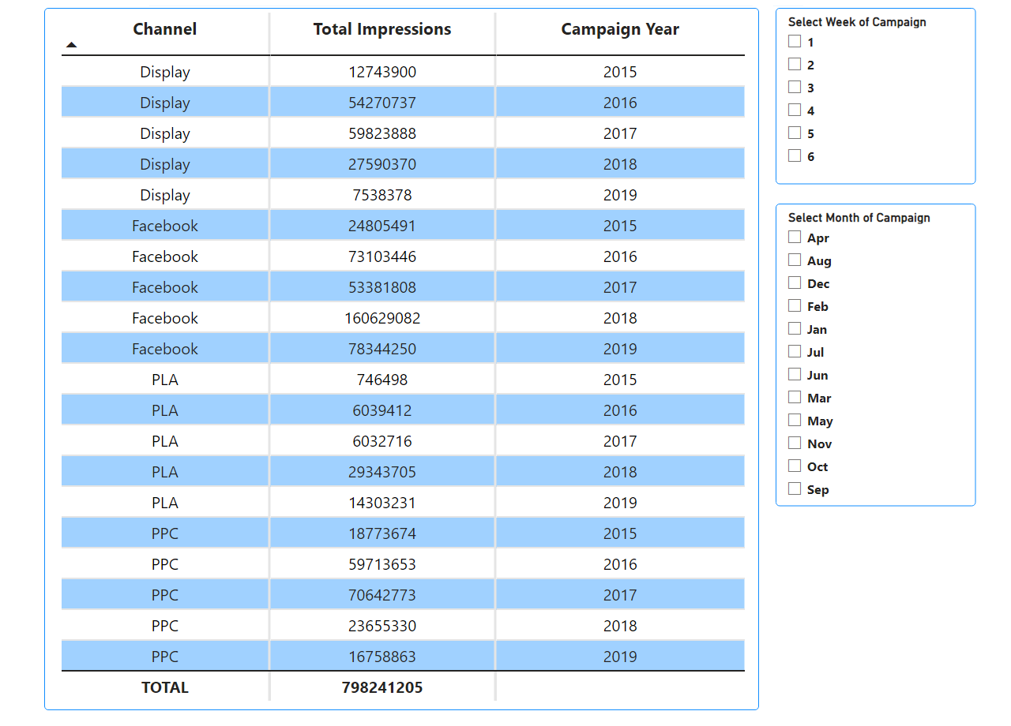

Slide 34
The above slide also shows a table of all media campaign channels.
These channels have been aggregated into the various years the campaigns was undertaken and the total impressions for each campaign channel with respect to each year (2015 to 2019).
In total we have four campaign channels in our data.
Display
Facebook
PLA – Product Listing Ad
PPC – Pay-Per-Click

Slide 35
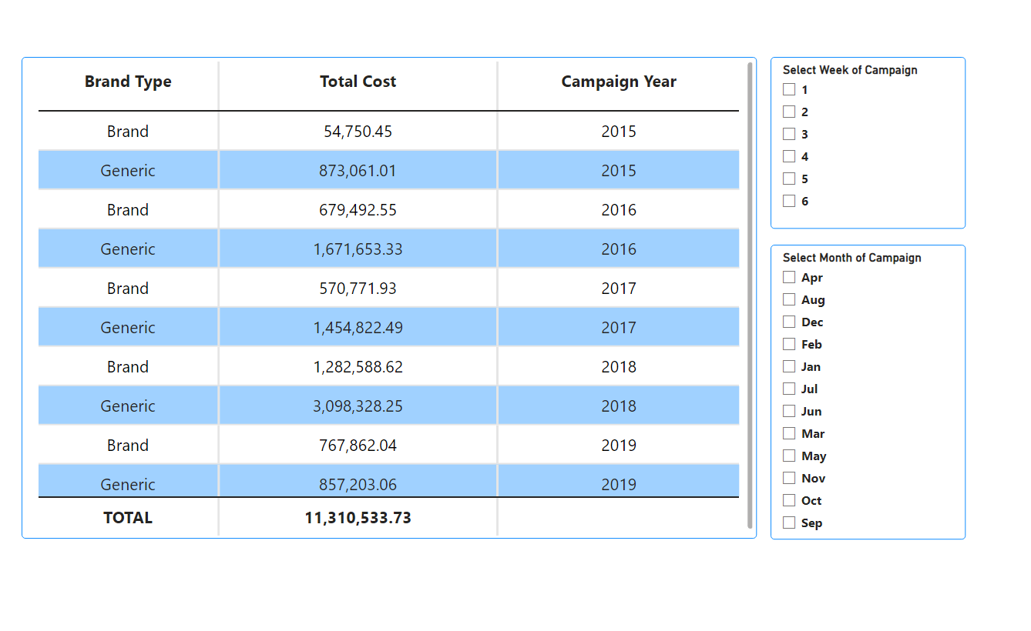

Slide 36
The slide above looks at the campaign brand types in our data.
The table shows the total cost of each brand type;
Brand
Generic
in the media campaign and groups them according to the years recorded (2015 to 2019).
So for both brand types, the corresponding cost and year is generated as shown in the table above.

Slide 37
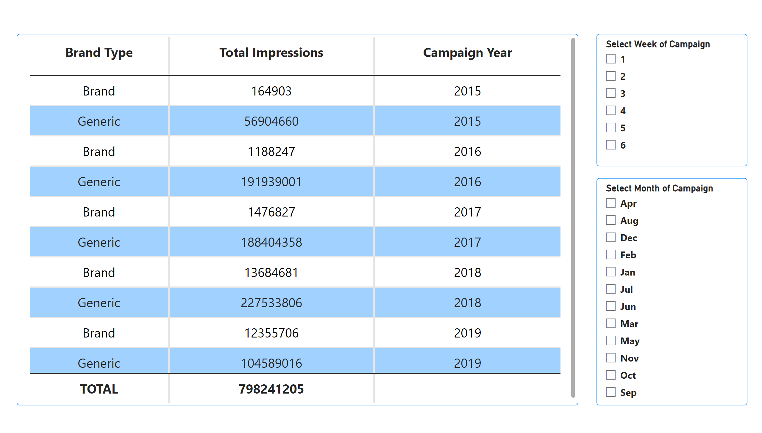

Slide 38
The slide above looks at the campaign brand types and their impressions in our data.
The table shows the total impressions made for each brand type;
Brand
Generic
in the media campaign and groups them according to the years recorded (2015 to 2019).
For both brand types, the corresponding impressions and year is generated as shown in the table above.

Slide 39
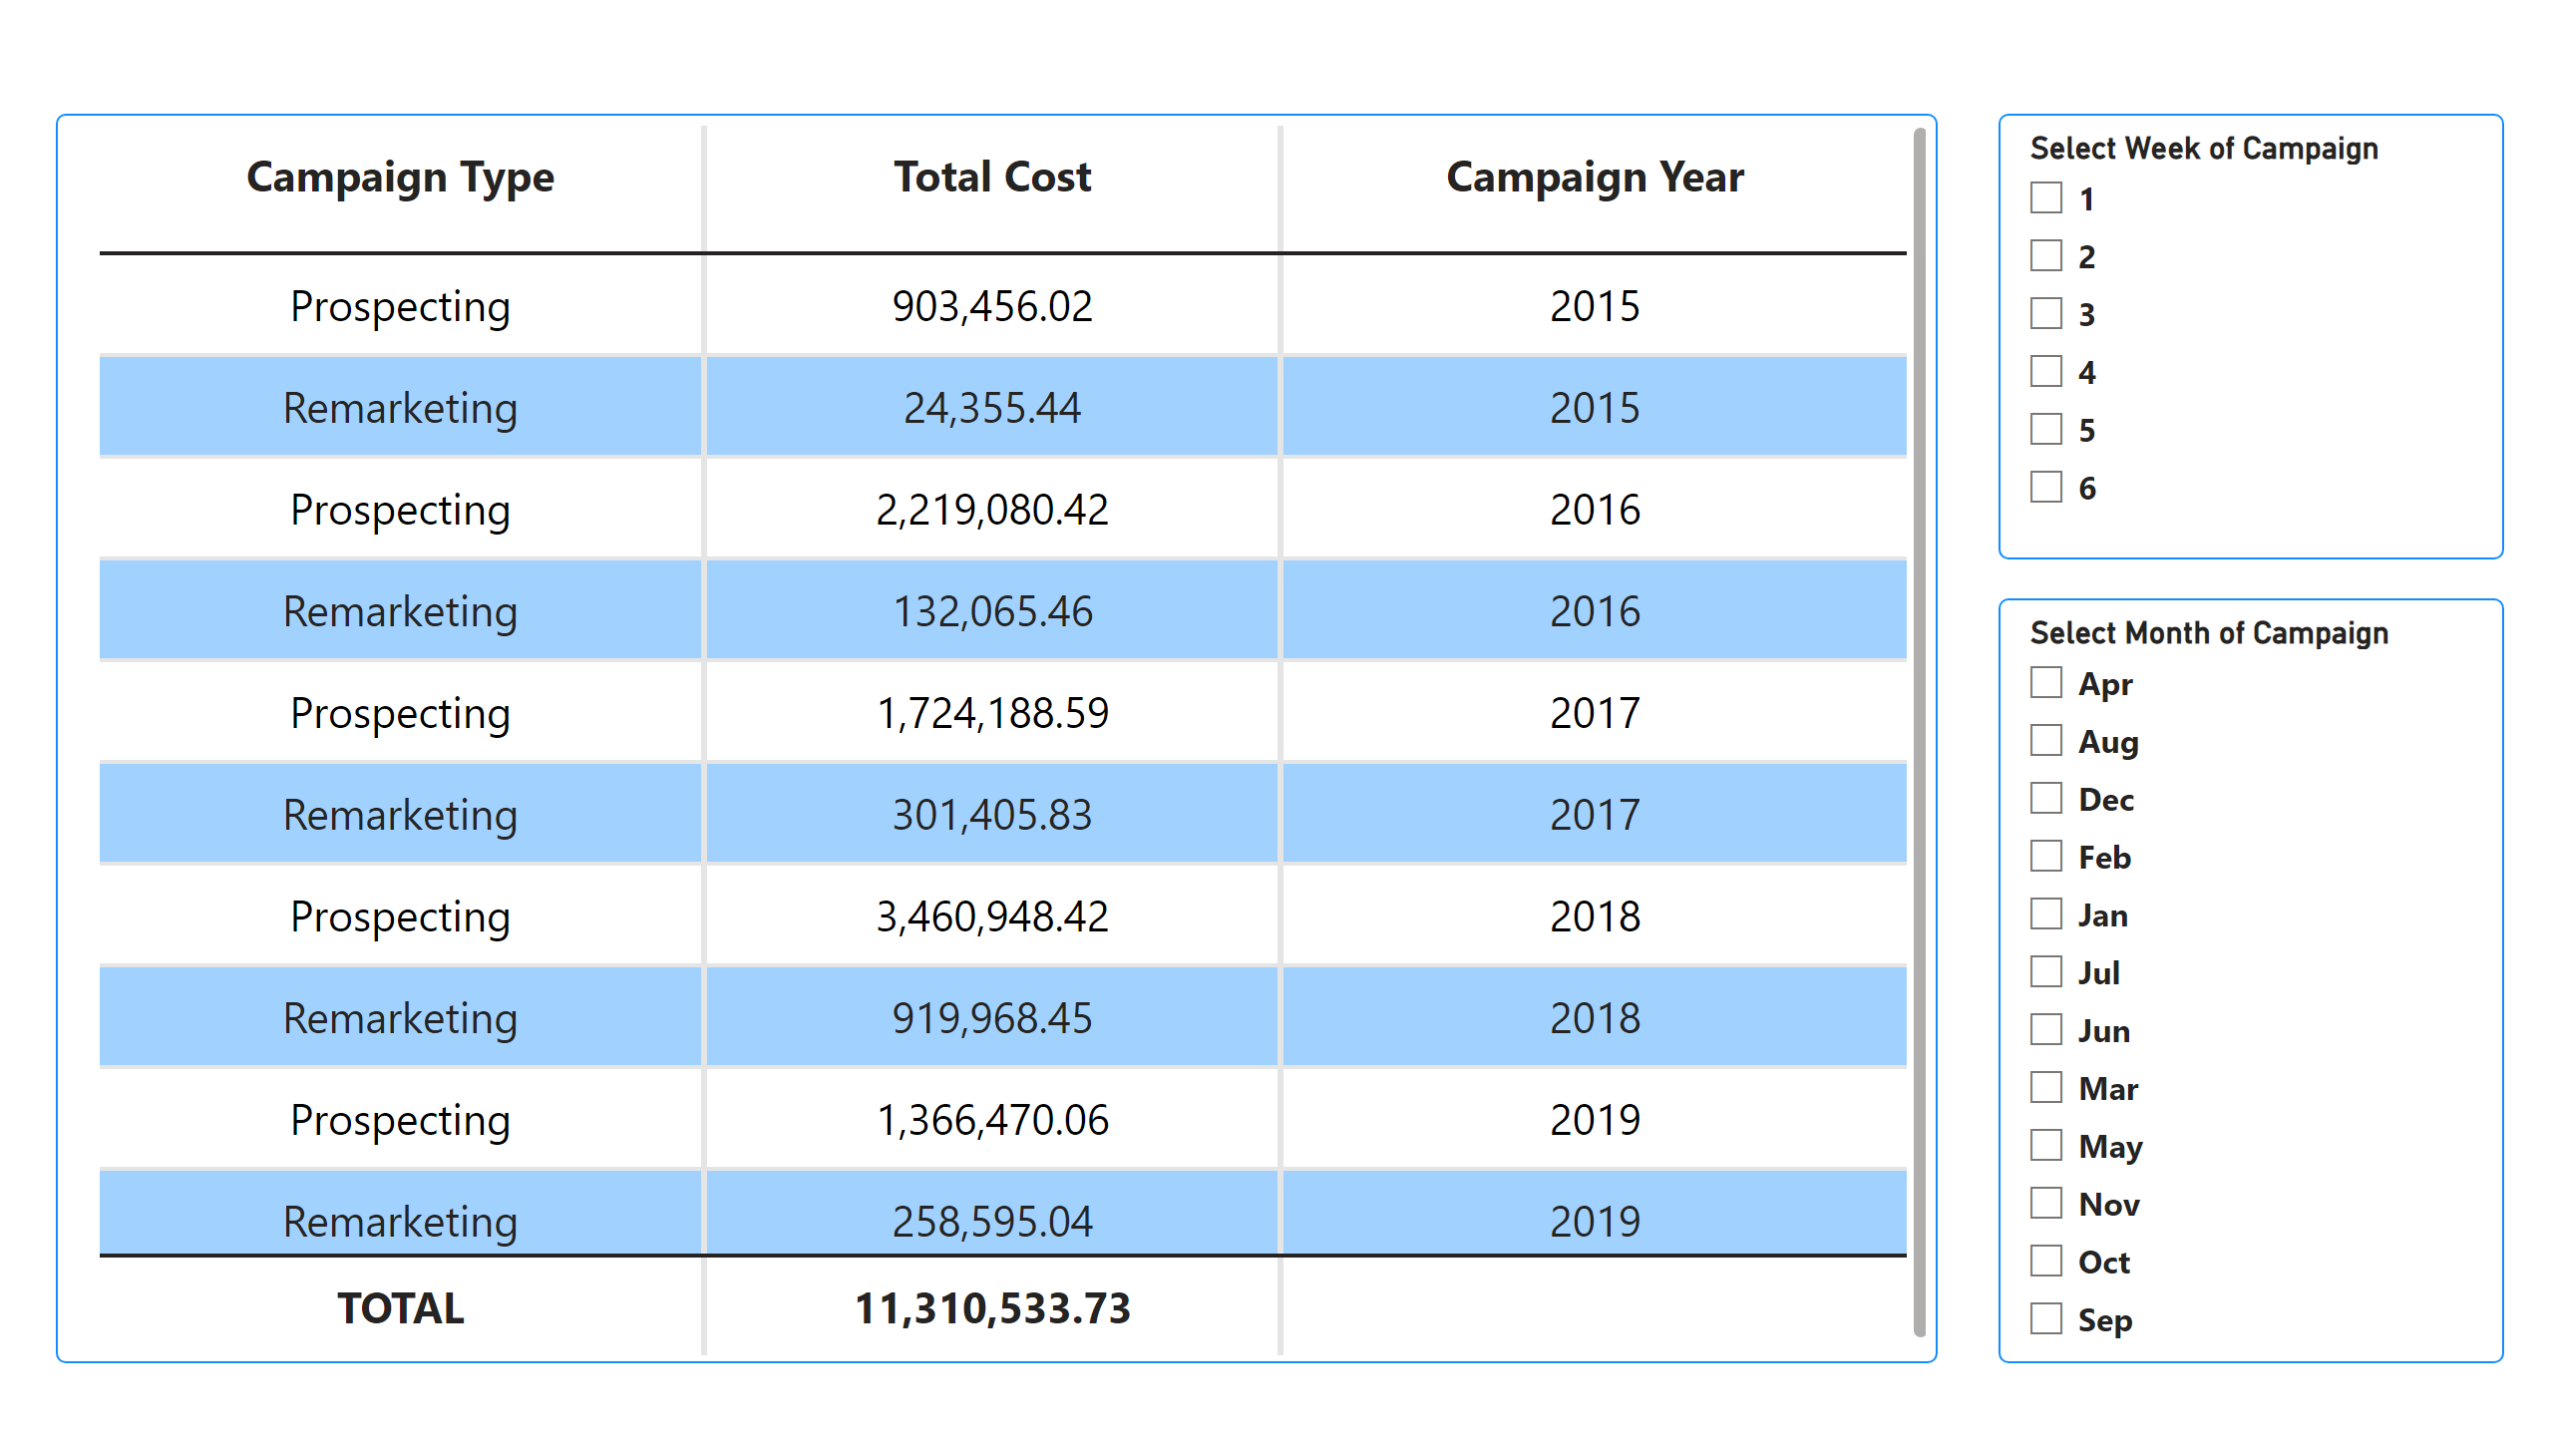

Slide 40
The slide above looks at the campaign types in our data.
The table shows the total cost of each campaign type;
Prospecting
Remarketing
during the media campaign and groups them according to the years recorded (2015 to 2019).
So for both campaign types, the corresponding cost and year is generated as shown in the table above.

Slide 41
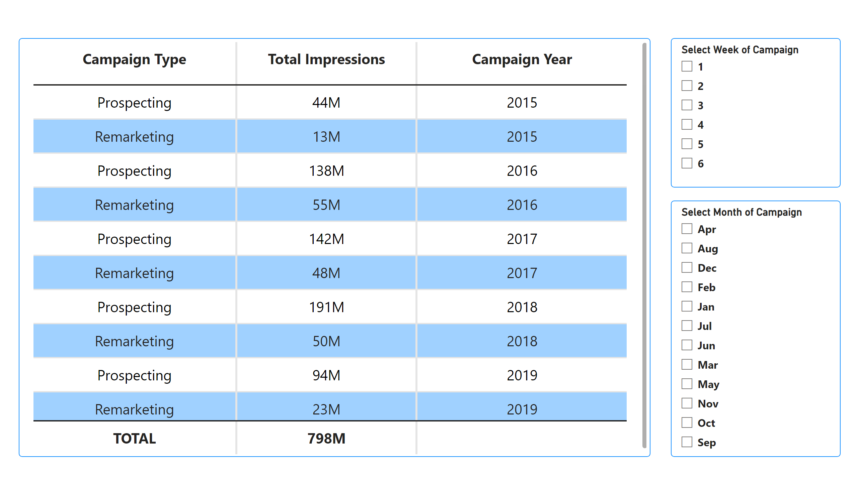

Slide 42
The slide above looks at each campaign type and their respective total impressions count in our data.
The table shows the total impressions count made of each campaign type;
Prospecting
Remarketing
in the media campaign and groups them according to the years recorded (2015 to 2019).
So for both campaign types, the corresponding total impressions count and the respective year is generated as shown in the table above.

Slide 43
RECOMMENDATIONS
Although much key trends and insights were gleaned from the available media data, more in-depth analysis could be done further to optimize future campaigns. Below are a number of recommendations:
Proper names should be given to the campaigns to make the communication of analysis easy to stakeholders.
Location of campaigns could be added to aid in more in-depth aggressions and analysis.
Abbreviations should be avoided or full names should be provided to aid in more in-depth analysis.
Currency associated with the cost of campaigns must be indicated to avoid ambiguity in cost analysis.

Slide 44
RECOMMENDATIONS CONTD.
Apart from the two recorded campaign types (prospecting and remarketing). I suggest the utilization of other campaign types like;
Brand Awareness: These campaigns focus on creating visibility and familiarity for the brands among a target audience.
User-Generated Content (UGC) Campaigns: This encourages customers to create and share content related to a brand or its products. These campaigns leverage user-generated content, such as reviews, testimonials, or social media posts, to amplify brand reach and authenticity.
Seasonal or Holiday Campaigns: These are timed around specific seasons or holidays, these campaigns leverage the festive spirit to engage with the audience. These often incorporate relevant themes, offers, or promotions that align with the occasion.

Slide 45
RECOMMENDATIONS CONTD.
Apart from display advertising, Facebook, Product Listing Ads (PLAs), and Pay-Per-Click (PPC) campaigns, there are several other channels that the media campaign can utilize. Here are a few examples:
Social Media Advertising: In addition to Facebook, we can consider utilizing other social media platforms like Instagram, Twitter, LinkedIn, or Pinterest depending on your target audience and campaign objectives.
Influencer Marketing: Collaborate with relevant influencers or content creators in a specific industry to promote a brand or products. Influencer marketing can help reach a specific niche audience and build trust through authentic endorsements.
Affiliate Marketing: Partnering with affiliate networks or individual affiliates who promote brands, products or services on their websites or social media channels. This performance-based marketing model can drive traffic and sales

Slide 46
CONCLUSION
In concluding, this data validation and analysis for our client’s media campaign has provided valuable insights and ensured the accuracy and reliability of campaign related data. We have examined the performance of our campaigns from 2015 to 2019 and gained key takeaways that will shape future media campaign strategies.
Through the validation process, we have reaffirmed the importance of data-driven decision-making in optimizing media campaigns. The analysis has allowed us to identify trends, patterns, and actionable recommendations that will drive improvements in targeting, ad placement, content optimization, and budget allocation.
***THANK YOU***

